Slide 1
Software Design & Development CFS2160
Week 17 – Java Inheritance

Slide 2
Session Plan
Look at the importance and use of inheritance.
Work through an example (start IntelliJ now please).
Finally.

Slide 3
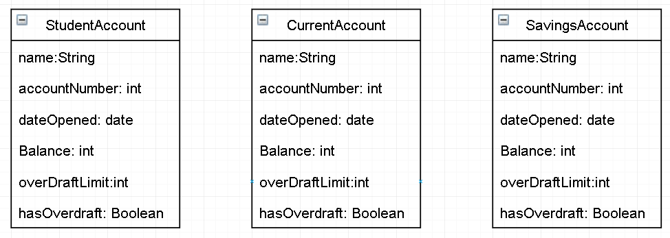
Example Classes
Lets look at the Accounts Classes in the bank systems.
What are some common Attributes of the classes?
What is wrong with these classes?

Slide 4
Example Classes
Lets look at the Accounts Classes in the bank systems.
What are some common Attributes of the classes?
They have got similar attributes therefore code smell and we don’t like it!

Slide 5
Java Inheritance
Tony always says we should whenever possible re-use code to avoid code smell.
If we were to add those common attributes into each of our account classes, we would be breaking that rule!
It would be nice if we could avoid this, we can with inheritance.
If we create an Account class we can then create child classes, such as StudentAccount that extend / inherit (therefore can use) the attributes and properties of Account.

Slide 6
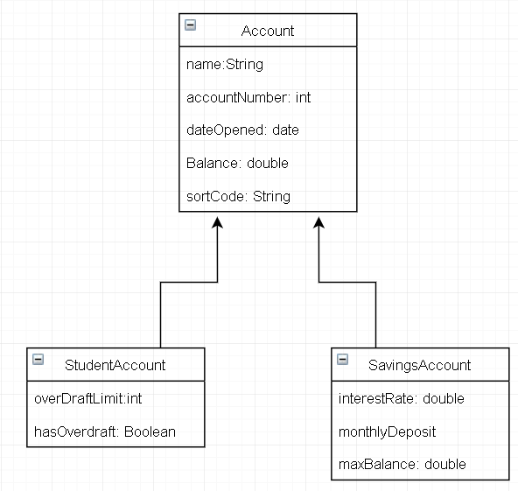
Example Classes - Improved
We have a ‘Parent Class’ called Account which contains just the attributes and methods that are common to all possible types of account class
We then have ‘child classes’ which have unique attributes and Extend (inherit) the attributes of its Parent Class.

Slide 7
Inheritance in Action
Create a new package called Bank
Create a new class called Account in the package
public class Account { private String name; private int balance; private String accountNumber; }
Add the required attributes to the class

Slide 8
Inheritance in Action
Add a constructor with all attributes to the Account class
Add the default (empty) constructor to the Account class
public Account(String name, int balance, String accountNumber){ this.name = name; this.balance = balance; this.accountNumber = accountNumber; }
public Account(){}
Add all getters and setters to the Account class
Add withdraw() and deposit() methods to the Account class

Slide 9
Initial Account Class
package Bank; public class Account { private String name; private int balance; private String accountNumber; public Account(String name, int balance, String accountNumber) { this.name = name; this.balance = balance; this.accountNumber = accountNumber; }
public Account(){} public String getName() { return name; } public void setName(String name) { this.name = name; } public int getBalance() { return balance; } public void setBalance(int balance) { this.balance = balance; } public String getAccountNumber() { return accountNumber; } public void setAccountNumber(String accountNumber) { this.accountNumber = accountNumber; } public void withdraw(){} public void deposit(){} }
You should now have a class that resembles something like this.

Slide 10
Inheritance in Action
Add a class called StudentAccount to the package
Add ‘extends Account’ to the class as shown below
Extends is the keyword used to inherit a class into another
package Bank; public class StudentAccount extends Account{ }

Slide 11
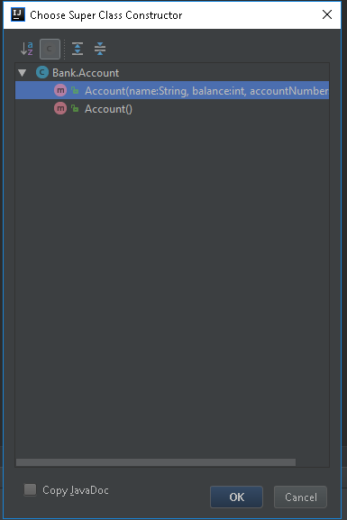
Inheritance in Action
Add a constructor to the StudentAccount class using ‘Code>Generate>Constructor’
We now have the option to choose which constructor in the super class (Account) we wish to use, select the one with the values in the round brackets.
Note, In the title bar the message says ‘Choose Super Class Constructor’. This means we are using the constructor of the super class (Account).

Slide 12
Inheritance in Action
Our StudentAccount class should now look like this
package Bank; public class StudentAccount extends Account{ public StudentAccount(String name, int balance, String accountNumber) { super(name, balance, accountNumber); } }
You can see that although our StudentAccount class does not have attributes, the ‘Code>Generate>Constructor’ function of intellJ has added name, balance and accountNumber to the constructor, these attribute have been fetched from the Account (super) class constructor, this can happen because we added the ‘extends’ keyword and the ‘Account’ class name to StudentAccount.
The ‘super’ keyword is used to pass the values gathered when creating an object of StudentAccount to its parent (Account) class.

Slide 13
Inheritance in Action
Add a toString() method to StudentAccount
@Override public String toString() { return "StudentAccount{}"; }
Because we have not added any attributes to StudentAccount, there are no attributes that can be printed in the toString() method, just the basic String to be outputted.

Slide 14
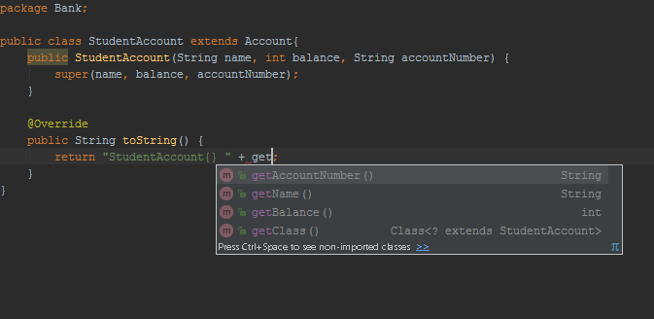
Inheritance in Action
But, because we are extending Account, we have access to the getters and setters of the super class because they are public methods.
You can see in the image below that typing ‘.get’ suggests methods available in the super class (Account) but not in the StudentAccount.

Slide 15
Inheritance in Action
Add the getter methods declared in the Account class, into the toString() method in StudentAccount to get the values, your class should now look like this.
package Bank; public class StudentAccount extends Account{ public StudentAccount(String name, int balance, String accountNumber) { super(name, balance, accountNumber); } @Override public String toString() { return "Name " + getName() + ", Account Number " + getAccountNumber() + ", Balance " + getBalance(); } }

Slide 16
Attributes in Child Class
We can now add attributes and getters and setter methods into the child (StudentAccount) class that are unique to that class.
These attributes and methods can be used in the same way as we have done so far.
We add the toString() method to the child classes and can use the parent class and child class methods.

Slide 17
Inheritance in Action
Add a Bank class to the package
Add a constructor to this class
Add the main method to this class
Add the code to create an object of the class in the main method
package Bank; public class Bank { public Bank() { } public static void main(String[] args) { new Bank(); } }
Your Bank class should now look like this

Slide 18
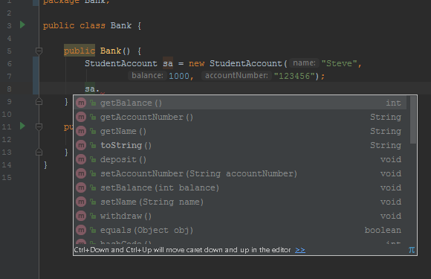
Inheritance in Action
Add the code to create an object of StudentAccount in the constructor
By typing the name of the object we have just created (sa) followed by . We now have access to the getters and setters of the super class (Account), we can use these methods to print out values of our object of StudentAccount (sa).

Slide 19
Inheritance in Action
The complete Bank code.
package Bank; public class Bank { public Bank() { StudentAccount sa = new StudentAccount("Steve", 1000, "123456"); System.out.println(sa.toString()); } public static void main(String[] args) { new Bank(); } }
When we run the programme, the output windows will print the StudentAccount toString() method to screen.
Name Steve, Account Number 123456, Balance 1000

Slide 20
Finally
Download and run the code sample from Brightspace?
Add another type of account that follows the pattern of StudentAccount with unique attributes.
Continue working of outstanding tutorial work and ask me questions?
Inheritance is a crucial and integral part of any programming language, put some effort into learning how to use it. You will benefit from the effort!

